Slide 1

NPK Fertilizer
NPK, a key nutrient source for plants.

Slide 2

What is NPK
Nitrogen (N):
is responsible for promoting vigorous growth, particularly in the green, leafy parts of the plant. It is the key nutrient that drives photosynthesis, the process by which plants convert sunlight into energy.
Phosphorus (P):
is essential for the development of strong roots, aiding in energy storage and transfer within the plant. It plays a critical role during the flowering and fruiting stages, ensuring a healthy reproductive process.
Potassium (K):
on the other hand, contributes to the plant’s overall strength and resilience, enhancing its ability to resist diseases, regulate water uptake, and improve drought tolerance.
Together, these three nutrients form the foundation of balanced plant nutrition, leading to increased yield, better quality crops, and sustainable agricultural practices.

Slide 3

Plants Grown with NPK Fertilizer
Plants that receive NPK fertilizer get a balanced supply of the essential nutrients they need for growth and development: Nitrogen, Phosphorus, and Potassium. These plants exhibit the following characteristics:
Faster Growth: Nitrogen speeds up the growth of the plant's green leaves, contributing to a stronger and healthier plant.
Stronger Roots: Phosphorus promotes deeper and stronger root development, helping the plant anchor more firmly in the soil and absorb nutrients more effectively.
Higher Quality Produce: Potassium increases plants' resistance to diseases and improves the quality and quantity of fruits, vegetables, or grains.
Higher Yields: Plants that receive balanced nutrients generally produce higher yields and better-quality crops.
Plants Grown Without NPK Fertilizer
Plants that do not receive NPK fertilizer experience an imbalance in the essential nutrients they need for growth and development: Nitrogen, Phosphorus, and Potassium. These plants typically exhibit the following characteristics:
Slower Growth: Without sufficient nitrogen, the growth of the plant’s green leaves is stunted, leading to weaker and less healthy plants.
Weaker Roots: A lack of phosphorus results in poor root development, preventing the plant from establishing a strong anchor in the soil and reducing its ability to absorb nutrients effectively.
Lower Quality Produce: Without adequate potassium, plants are more vulnerable to diseases and the quality and quantity of fruits, vegetables, or grains they produce are significantly lower.
Lower Yields: Plants deprived of balanced nutrients generally produce smaller yields and lower-quality crops, which can affect overall production and sustainability.

Slide 4

HERE ARE THE PRODUCT NAMES
1 | NP 20.20 | Nitrogen Phosphorus
2 | NPK 15.15.15 | Nitrogen Phosphorus potassium
3 | AN | Ammonium Nitrate
4 | CAN | Calcium Ammonium Nitrate
5 | DAP | Diammonium Phosphate
6 | MAP | Monoammonium Phosphate
7 | PK | Potassiom Phosphate
8 | NK | Nitrogen potassium
9 | SOP | Sulphate of Potash
10 | MOP | Muriate of Potash
11 | TSP | Triple Super Phosphate

Slide 5

Meso-elements
Meso-elements play a crucial role in the growth and metabolic processes of plants. While they are required in smaller amounts compared to macro-nutrients, they are still essential for plant health. These include:
Calcium (Ca): Vital for cell wall structure and strengthening plant tissues. A lack of calcium can cause tissue breakdown in plants.
Magnesium (Mg): The central element in chlorophyll and critical for photosynthesis. Magnesium deficiency leads to leaf yellowing and overall plant weakness.
Sulfur (S): Essential for protein and enzyme synthesis. Sulfur is necessary for plant protein production and metabolic activities. Deficiency can result in developmental problems.

Slide 6
Micro-elements
Micro-elements are required in trace amounts but are critical for metabolic functions and the overall health of plants. These elements support enzyme activity and various physiological processes. Based on specific needs, the following micro-elements may be added to NPK fertilizers:
Iron (Fe): Plays a role in chlorophyll synthesis and energy production. Iron deficiency leads to chlorosis (leaf yellowing).
Zinc (Zn): Involved in the production of the plant growth hormone auxin. Zinc deficiency results in stunted growth and smaller leaves.
Boron (B): Crucial for cell division and pollen production. Boron deficiency causes reproductive issues and weak structural growth.
Copper (Cu): Supports enzymatic reactions and chlorophyll production. Copper deficiency leads to stunted growth and leaf deformities.
Manganese (Mn): Important for photosynthesis and nitrogen metabolism. Manganese deficiency results in chlorophyll loss and leaf spotting.

Slide 7
NPK Fertilizer and Product Names Enriched with Extra Elements
1 | NP 12:52 | 12 | NPK(S) 8:20:30 (2) +0.3B
2 | NP 18:46 | 13 | NPK(S) 8:20:30 (2) +1Zn
3 | NP 10:46 | 14 | NPK(S) 10:26:26 (2) +0.3B
4 | NP(S) 16:20 (12) | 15 | NPK(S) 10:26:26 (2) +1Zn
5 | NP(S) 20:20 (14) | 16 | NPK(S) 13:17:17 (6) +0.15B + 0.6 Zn
6 | NP(S) 14:40 (7) | 17 | NPK(S) 14:18:16 (6) +0.3B
7 | NPK(S) 10:26:26 (2) | 18 | NPK(S) 14:18:18 (6) +0.3 Zn
8 | NPK(S) 8:20:30 (2) | 19 | NPK(S) 15:15:15 (10) +0.3 B
9 | NPK(S) 15:15:15 (10) | 20 | NPK(S) 15:15:15 (10)+ 1 Zn
10 | NPK (S) 13:19:16 (6) | 21 | NP(S) 14:40(7)+ 1Zn
11 | NPK 12:32:16 | 22 | NP(S) 20:20 (14)+ 0.4 ZN

Slide 8

Importance of Soil Analysis
Soil analysis is essential to determine the most suitable fertilizer formula for the soil. It reveals the existing nutrients and deficiencies in the soil. Based on this information, the right NPK fertilizer with the proper ratio can be selected according to the plants’ needs. This ensures that plants receive the nutrients they require in a balanced way, leading to increased yield and quality.

Slide 9

Safety of NPK Fertilizers for Human Health
NPK fertilizers are a safe solution that meets the essential needs of plants and enhances agricultural production. When used correctly and in controlled amounts, NPK fertilizers ensure healthy plant growth without leaving harmful residues in the products consumed by humans. Widely used in agriculture, these fertilizers are developed in compliance with food safety standards and have no negative impact on human health. By following the recommended application guidelines, producers can increase crop yields while also protecting the environment and human health.

Slide 10
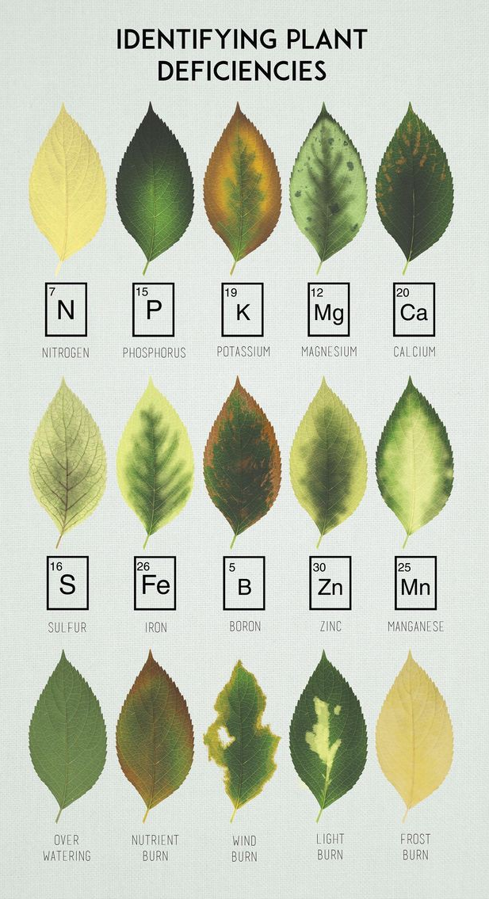
№ |  | Components | Roles in plant nutrition | Average application ates
1 | N | Nitrogen | Essential for leaf development and plant growth. | 48%
2 | P | Phosphorus | Promotes root development and energy transfer.
3 | K | Potassium | Enhances cell water balance and plant resilience
Meso-Elements:
1 | Mg | Magnesium | Key component of chlorophyll, essential for photosynthesis. | 5%
2 | Ca | Calcium | Strengthens cell walls and supports cell growth.
3 | S | Sulfur | Necessary for protein synthesis and enzyme functions.
Micro-Elements:
1 | Fe | Iron | Vital for chlorophyll synthesis and energy production | 1,5%
2 | B | Boron | Important for cell wall structure and sugar transport.
3 | Zn | Zinc | Supports growth hormone synthesis and protein production.
4 | Mn | Manganese | Plays a role in enzyme activity and photosynthesis.
5 | Cu | Copper | Involved in photosynthesis and enzyme reactions
Filler Materia:
6 |  | Bentonite | Improves soil structure increases water retention capacity, and act as a carrier in fertilizers. | 45%

Slide 11

Melek Global LLC
Tbilisi, Georgia
Mobile / WhatsApp: +995 579 121 987
Email: info24melekglobal@gmail.com

